Slide 1





Post 18 Options
Welcome

Slide 2
Post 18 Options
Purpose of this section
To introduce you to the Universities and Colleges Admissions Service (UCAS) and explain the timeline regarding your child’s applications
To introduce you to Careers/Apprenticeship alternatives and who to contact for help in this area
To introduce you to Unifrog:
‘We bring all the available information into one single, impartial, user-friendly platform that helps students to make the best choices, and submit the strongest applications.’
To help you to think about writing a good Personal Statement/CV

Slide 3
UCAS TARIFF TABLE
Diploma | Foundation Diploma | A2 & Applied Ext Cert | UCAS Points | AS & Core Ma | Applied Cert & EPQ
D*D* |  |  | 112
D*D |  |  | 104
DD |  |  | 96
 |  |  | 64
 | D* |  | 84
DM |  |  | 80
 | D |  | 72
MM |  |  | 64
 |  | A*/Dist* | 56
MP | M | A/Dist | 48
 |  | B | 40
PP |  | C/Merit | 32
 |  |  | 28 |  | A*/Dist*
 | P | D | 24 |  | A/Dist
 |  |  | 20 | A | B
 |  | E/Pass | 16 | B | C/Merit
 |  |  | 12 | C | D
 |  |  | 10 | D
 |  |  | 8 |  | E/Pass
 |  |  | 6 | E
What qualifications are our students doing?
How many ‘UCAS points’ do they get you?
Core Maths (1 year course)
AS (first year of GCE course – not all subjects do an AS exam!!)
Up to 20 UCAS points
Applied/BTEC Certificate (1 year equivalent of AS)
EPQ (1 year)
Up to 28 UCAS points
A2 (2 Year GCE course)
Applied/BTEC Extended Certificate (2 year equivalent of A2)
Up to 56 UCAS points
Applied/BTEC Foundation Diploma (equivalent of 1 ½ A Levels)
Up to 84 UCAS points
Applied/BTEC Diploma (equivalent of 2 A Levels)
Up to 112 UCAS points

Slide 4
UCAS TARIFF TABLE
Diploma | Foundation Diploma | A2 & Applied Ext Cert | UCAS Points | AS & Core Ma | Applied Cert & EPQ
D*D* |  |  | 112
D*D |  |  | 104
DD |  |  | 96
 |  |  | 64
 | D* |  | 84
DM |  |  | 80
 | D |  | 72
MM |  |  | 64
 |  | A*/Dist* | 56
MP | M | A/Dist | 48
 |  | B | 40
PP |  | C/Merit | 32
 |  |  | 28 |  | A*/Dist*
 | P | D | 24 |  | A/Dist
 |  |  | 20 | A | B
 |  | E/Pass | 16 | B | C/Merit
 |  |  | 12 | C | D
 |  |  | 10 | D
 |  |  | 8 |  | E/Pass
 |  |  | 6 | E
So,
Johnny scores the following success in his courses:
English Literature (A2 GCE) – A
Applied Science Extended Certificate – Merit
EPQ – B
Core Maths – B
Johnny has:
48 + 32 + 20 + 16 = 116 UCAS points
What about Aisha?
Applied Business Diploma – DD
Economics (A2 GCE) – A*
Core Maths – A
Aisha has:
96 + 56 + 20 = 172 UCAS points
REMEMBER – STUDENTS HAVE TO DO THE EQUIVALENT OF 3 A LEVELS AS THE MINIMUM REQUIREMENT FOR SIXTH FORM

Slide 5
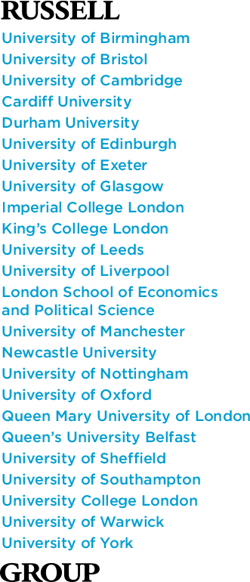
Some Universities will give a target number of UCAS points for the course(s) applied for
However, some may insist upon a combination of grades.
You can see how this works out on the graphic to the right:
Some Universities insist upon one or two ‘facilitating’ subjects included in your choices:
What are facilitating subjects?
The Russell Group, which represents 24 leading UK universities, defines facilitating subjects as:
English literature
History
Modern languages – e.g. French, German, Spanish etc.
Classical languages – e.g. Latin, Ancient Greek
Maths and Further Maths
Physics
Biology
Chemistry
Geography

Slide 6
Post 18 Options
Some University/subject specifics:
Interested in Oxford or Cambridge | Students will need to be studying all A levels with at least two of these being facilitating subjects. Lowest GCSE profile is usually 8 x GCSEs at grade 8. A level predictions will need to be a minimum of A*AA (A*A*A for science courses). Early deadline
Medicine or Dentistry | As above except minimum predictions can be AAA. Must have Chemistry, usually Biology and ideally Maths. Should be signed up to The Medic Portal and be aware of the UCAT/early deadline requirement
Physiotherapy | AAB/136 profile, including B in Biology – Applied Science may be accepted if Distinction in at least one Biology unit. Highly oversubscribed
Optometry | AAB/136 profile - requires 2 pure sciences (Bi, Ch, Ph or Maths)

Slide 7
Post 18 Options
Some University/Subject Specifics:
Midwifery | ABB/128 profile – Applied Science/Health & Social care accepted but highly oversubscribed so most students will be predicted higher than the minimum entry requirements
Pharmacy | ABB/128 profile - requires Ch or Bi and one other science (Psychology may be counted as a science in this instance)
Radiography | ABB/128 profile – to include a science or Maths
Nursing | BBC/112 profile – no specific subjects specified

Slide 8
Post 18 Options
Some University/Subject Specifics:
IMPORTANT:
When looking through entry requirements – check beyond the headlines!!!
For example:
Pharmacy at Bradford University

Slide 9
Post 18 Options
Contextual Offers:
Contextual offers are when universities take into account applicants’ personal circumstances before making an offer. For example: Access to Leeds
For example, a university’s normal entry requirements might be ABB at A-Level, but if a student meets certain criteria they will lower the requirements to something like BBC.
Some criteria for a contextual offer:
You have a disability
You’re a young carer
You’ve had your educational studies hindered by circumstances in your personal, social or domestic life
You’ve been separated from your family
You’re applying from an eligible school, lower than National Averages (Not BGS, but you may have been at one previously).
You’ve spent time in local authority care
You’re a refugee
You’re a first generation Higher Education attendee (you’re the first in your family to attend higher education)
You’re entitled to the 16-19 bursary or free school meals

Slide 10
Post 18 Options
So, how am I doing?
Minimum Expected Grade (MEG)
This is the grade a student should achieve as a minimum, based upon previous school performance, GCSEs (even down to your postcode!)
A student can achieve higher than this grade. (There are no A* minimum target grades.)
Current Grade
This is the level a student is performing at in their subject NOW! Often it will be lower than their MEG as they have not completed all the content. If it is higher, well done!
Predicted Grade
This is the teacher’s estimate of the student’s final grade. If it’s below the MEG, they need to sort this out! If it is on or above, they are doing the business!

Slide 11
Post 18 Options
So, how is your daughter/son doing?
Minimum Expected Grade (MEG)
Current Grade
Predicted Grade
These should all be used to work out what sort of course could be realistically achieved when applying to University.
Additionally, teachers will give a UCAS prediction for applications, per subject.
Although we try to be positive, there is no value in predicting beyond what a student can realistically achieve!!!
Bernard’s predictions are C/C/C
Pointless in applying for a course wanting A/A/A
Bernard should therefore think carefully about his course choices (perhaps B/C/C at a push!)
Bernard would also be advised not to pester staff into upping his predictions!!!!!

Slide 12
Post 18 Options
Timeline
September and October | Settling into the Sixth Form. Developing skills to be an effective independent learner. Initial Subject Assessments.
November and December | Focus on Future Opportunities. Using the Unifrog Destinations Platform. Oxbridge and Medics Sessions.
January to April | Tutor Sessions. Focus on Extra Curricular and Super Curricular. Personal Statements. Options at 18/Higher Education Guidance Event and Students.
May and June | External Exam Season.
July | UCAS Sessions. Focus on Careers.
YEAR 12

Slide 13
Post 18 Options
Timeline
30 September | School deadline for applications to Oxbridge and for medical, veterinary and dentistry applications.
15 October | UCAS deadline for early entry applications.
1 December | School deadline for UCAS applications.
Late January | UCAS deadline for application that are guaranteed to be considered by institutions.
February to April | Tutor Mentoring. Careers Interviews. Focus on Apprenticeships.
May and June | External Exam Season.
We advise students to attend university Open Days at the weekend or during the school holiday whenever possible.

Slide 14
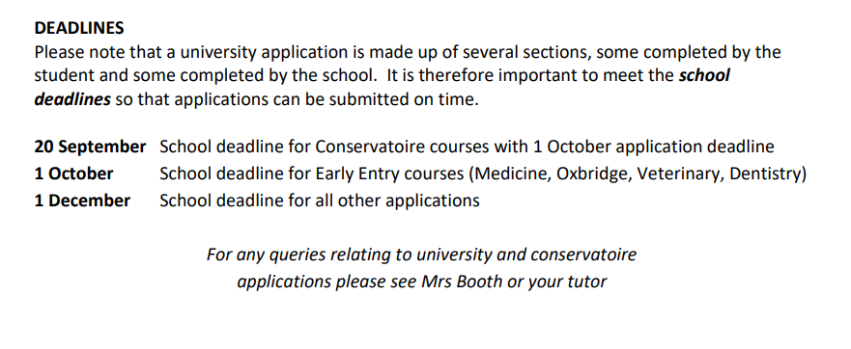
Post 18 Options

Slide 15
Post 18 Options
Admission Tests – Medicine
UCAT – University Clinical Aptitude Test
A computer-based admissions test, used by a consortium of UK Universities and non-UK associate member universities to help select applicants for their medical and dental degree programmes.

Slide 16
Post 18 Options
Personal Statements – How can I strengthen?
Super-curricular activities
Super-curricular activities are those that take the subjects a student studies further, beyond that which the teacher has taught them or what they've done for homework. A student may go into more depth on something picked up in the classroom or learn about a new topic altogether.
They can delve deeper into their subject in many ways, such as:
reading books, specialist magazines and journals.
visiting museums and galleries.
watching films and documentaries.
listening to podcasts.
attending online seminars and lectures.
entering academic competitions.

Slide 17
Post 18 Options
Personal Statements – How can I strengthen?
MOOCS (Massive Open Online Course)
A MOOC offers free education in an online environment, with no limit on class size.
It refers to an online course that allows users from across the world to learn the same material, without prerequisites, in a flexible learning environment.
In some cases, a MOOC can boost your application.
(One student applying to Durham University last year was compromised by her lack of MOOC!)

Slide 18
Post 18 Options
Personal Statements – How can I strengthen?
EPQ – Extended Project Qualification
Already mentioned and can add strength not only to an application, but also to research and study skills.
There will be the chance to complete in Year 13

Slide 19
Post 18 Options
Personal Statements – Enrichment
Paired Reading | Charity Fundraising
Introduction to Sign Language | Subject and Faculty Support
Amnesty International | Max 7 Volunteers
Scholars Programme | Paired Maths Support
Philosophy Group | Music Groups
Enactus | Sports Clubs
Restart a Heart CPR Training

Slide 20
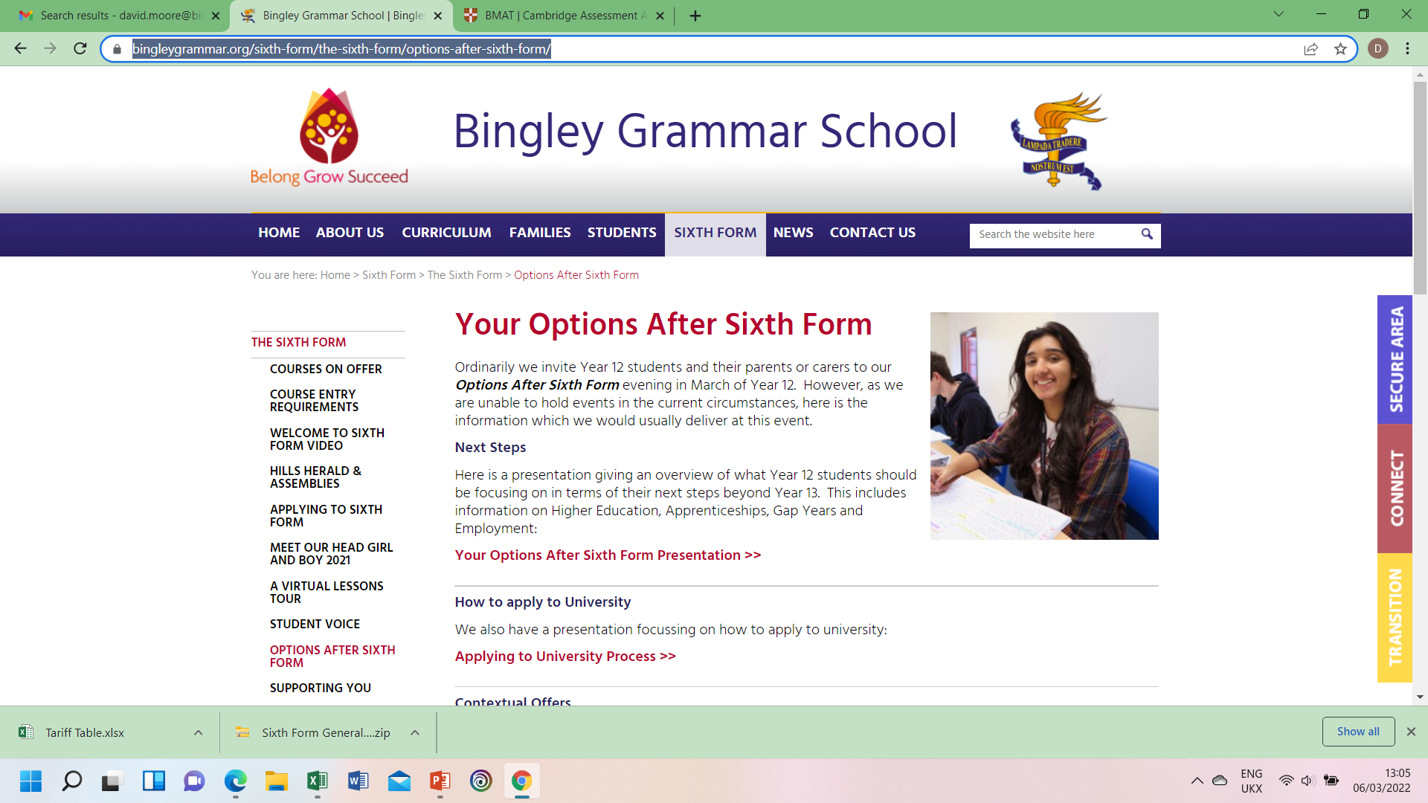
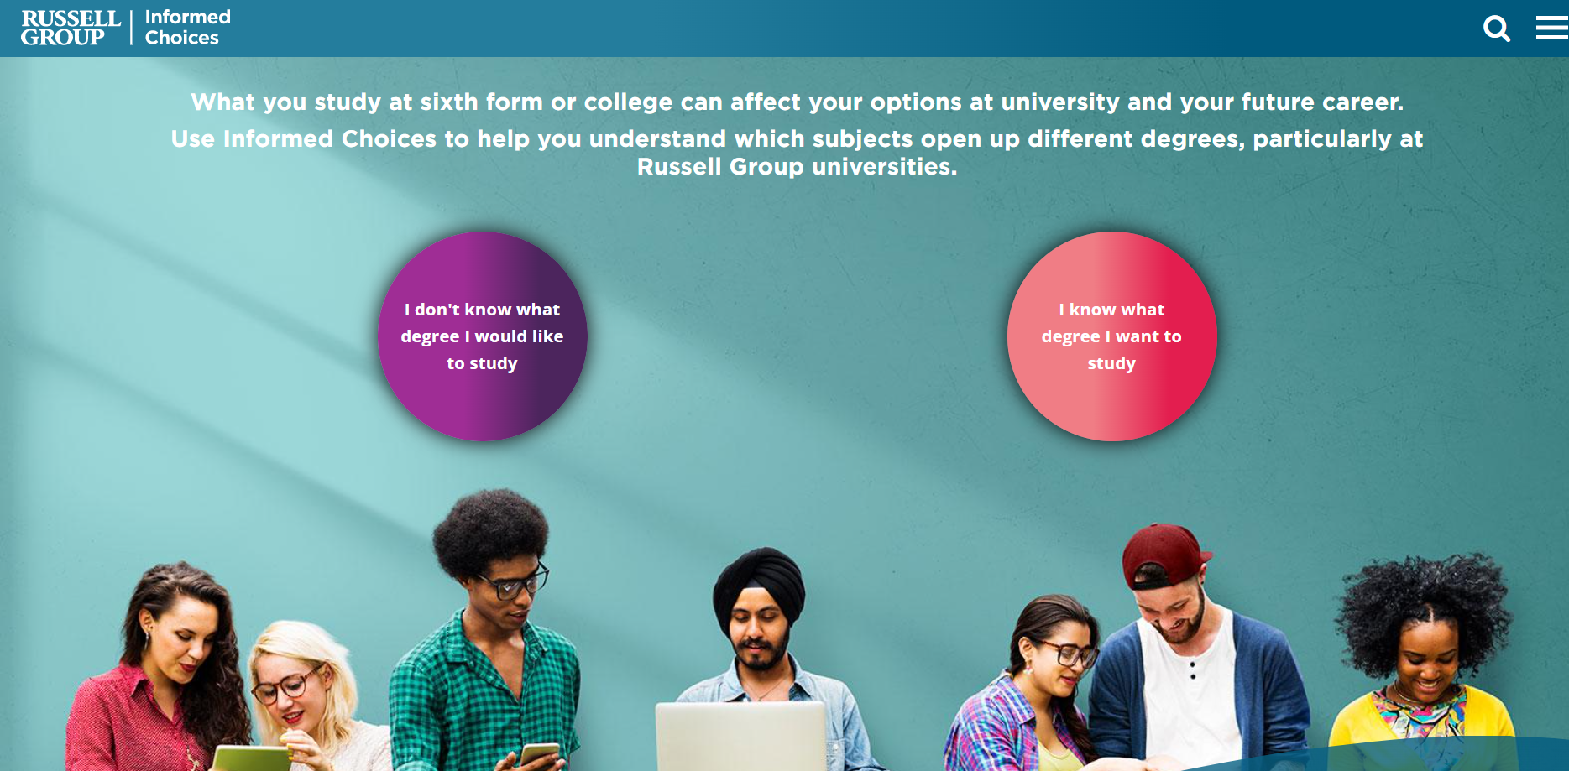
Post 18 Options
All this information is on the Sixth Form Website:
https://www.informedchoices.ac.uk/

